Slide 1
Object Oriented Programming Lecture - 23
Prof. Varsha Dange

Slide 2
User-defined Custom Exception
in Java

Slide 3
User-defined Custom Exception
Java provides us facility to create our own exceptions
which are basically derived classes of Exception.
For writing custom checked exception, extend Exception class.

Slide 4
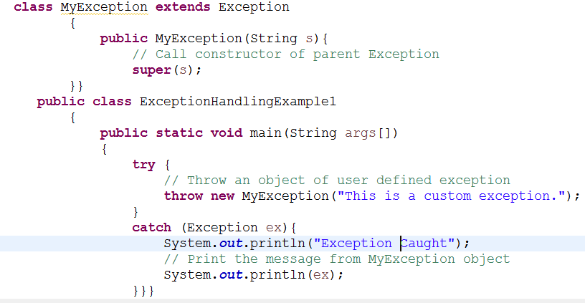

Contd…
Output:

Slide 5
Throwable Class Methods In Java
1. getMessage(): returns the message string about the exception.
2. getCause(): returns the cause of the exception. It will return null is cause is unknown or non-existent.
3. toString(): returns a short description of the exception.
Description of the exception = class name + “: “ + message.

Slide 6
Contd..
4. printStackTrace(): prints the short description of the exception (using toString()) + a stack trace for this exception on the error output stream(System.err).

Slide 7
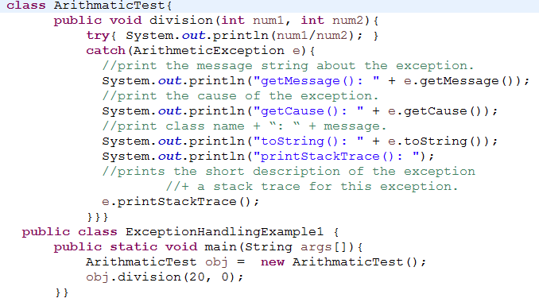
Example

Slide 8
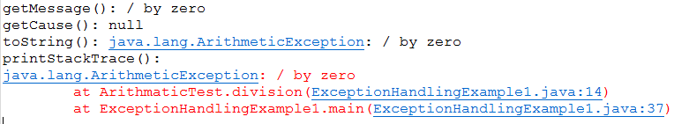
Contd…
Output:

Slide 9
Chained Exception
Chained exception in Java is a technique to handle exceptions that occur one after another.
This technique helps us to know when one exception causes another.
For example, let us assume that a, b, and c are objects of three different exception types A, B, and C respectively. The object a of type A causes an exception of type B to occur and an object of B type also causes an exception of C type.

